Slide 1
What is a Mineral

Slide 2
What is a Mineral
A naturally occurring chemical compound characterized by a definite crystalline structure

Slide 3
A Mineral Species
Species: Corundum
Ideal Chemical Formula: Al₂O₃

Slide 4
What would “idea” end-member corundum look like?

Slide 5
What would “idea” end-member corundum look like?
How would you find out?

Slide 6
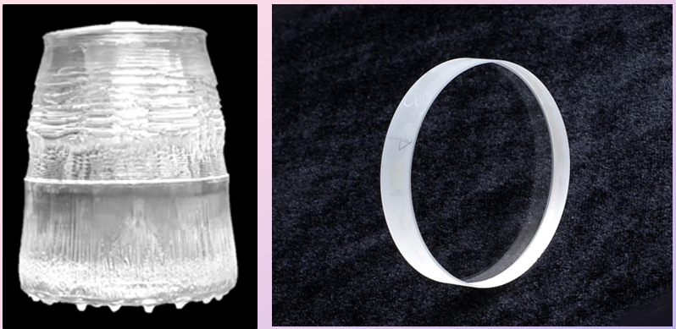
Synthetic Pure Al₂O₃ is colorless
Daiichi-Dentsu Company Creator Optics

Slide 7
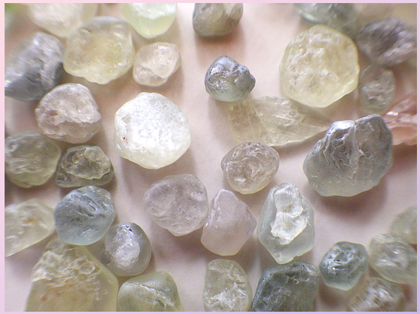
Montana Corundum

Slide 8
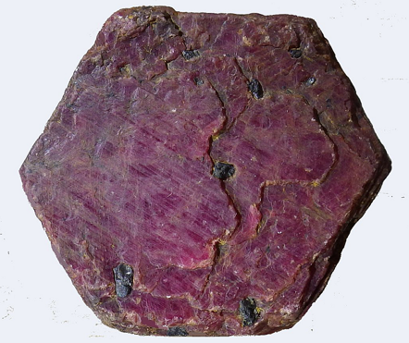
Properties?
Corundum crystal from India

Slide 9
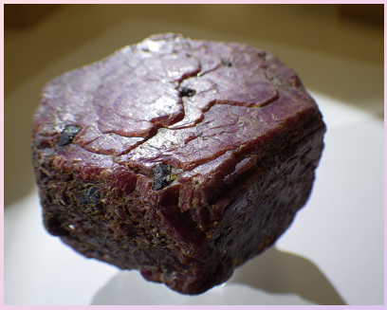
Properties?

Slide 10
Color
Color leads us to three concepts:
Solid Solution
(Al_{1.97}M³⁺_{0.03})_{Σ=2.00}O₃

Slide 11
Color
Color leads us to three concepts:
Solid Solution
What Elements Are Present?
What factors to consider?
Notes:
Charge, Ionic Radius

Slide 12
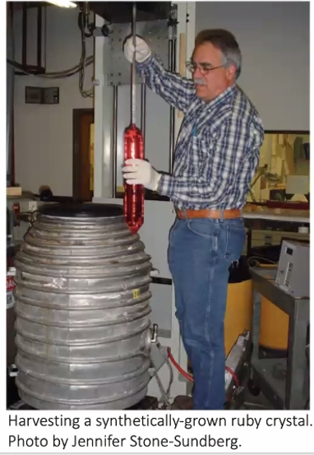
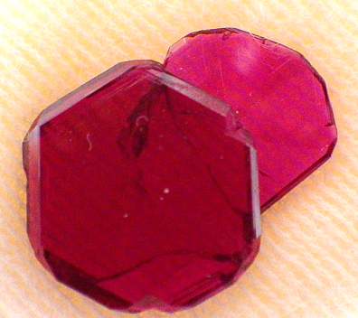
Synthetic Al₂O₃ with Cr³⁺

Slide 13
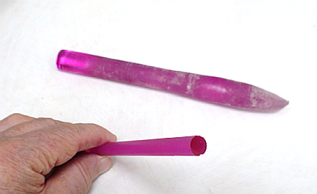
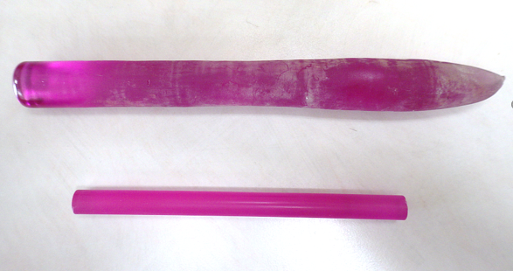
Synthetic Al₂O₃ with Cr³⁺

Slide 14
Color
Color leads us to three concepts:
Solid Solution
(Al_{1.97}M³⁺_{0.03})_{Σ=2.00}O₃
Al₂O₃ ↔ Cr₂O₃
corundum ↔ eskolaite

Slide 15
Color
Color leads us to three concepts:
Solid Solution
Variety

Slide 16
Color
Color leads us to three concepts:
Solid Solution
Variety: Red from Cr³⁺ = ruby

Slide 17
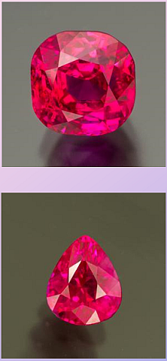
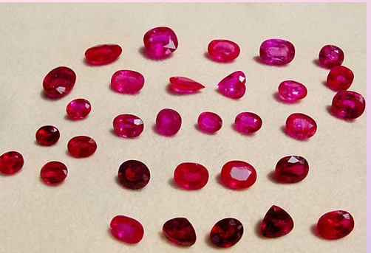
Rubies
Photo Credits: Pala International

Slide 18
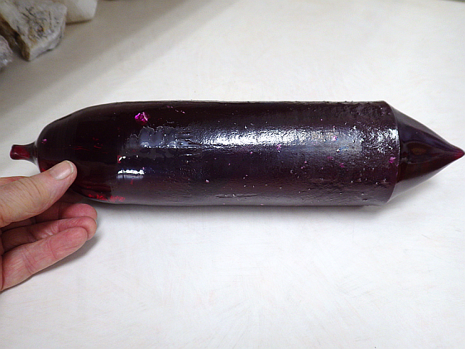
Synthetic Ruby Boule
Growth Temp = 2053°C

Slide 19
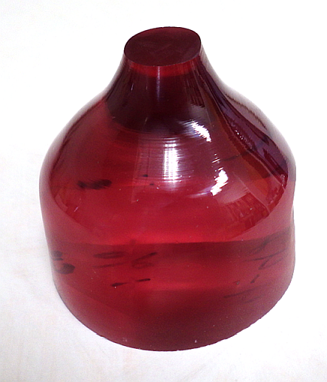
Ti³⁺ in corundum

Slide 20
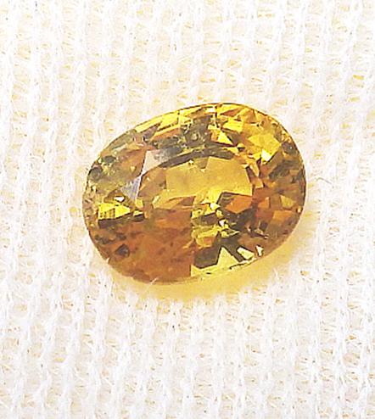
Fe³⁺ in corundum

Slide 21
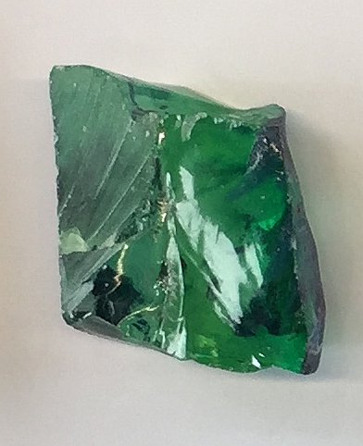
Cobalt in corundum

Slide 22
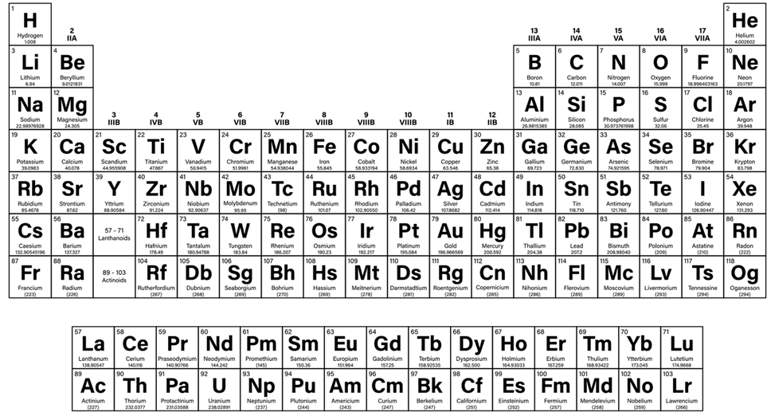
Other Elements ?

Slide 23
Other Elements

Slide 24
Other Elements

Slide 25
Other Elements

Slide 26
Color
Color leads us to three concepts:
Solid Solution
Variety
Coupled Substitution: 2 Al³⁺ = M²⁺ + M⁴⁺

Slide 27
Color
Color leads us to three concepts:
Solid Solution
Variety
Coupled Substitution: 2 Al³⁺ = Fe²⁺ + Ti⁴⁺

Slide 28
Color
Color leads us to three concepts:
Solid Solution
Variety
Coupled Substitution: 2 Al³⁺ = Fe²⁺ + Ti⁴⁺
Known as sapphire

Slide 29
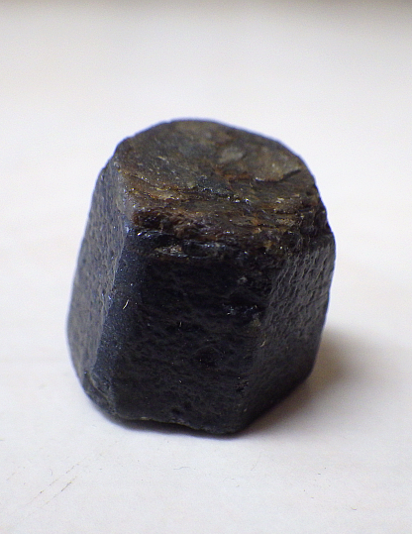
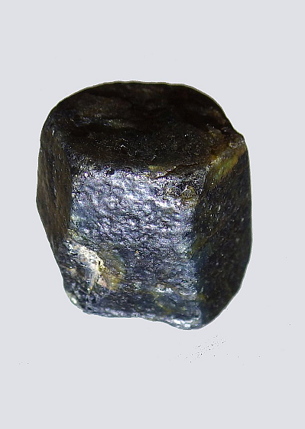
Sapphire from Laos

Slide 30
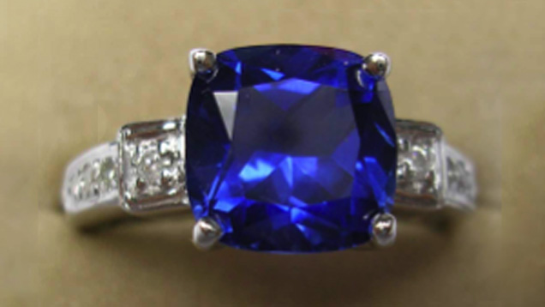
Sapphire Gems
Photo courtesy of Tairus.

Slide 31
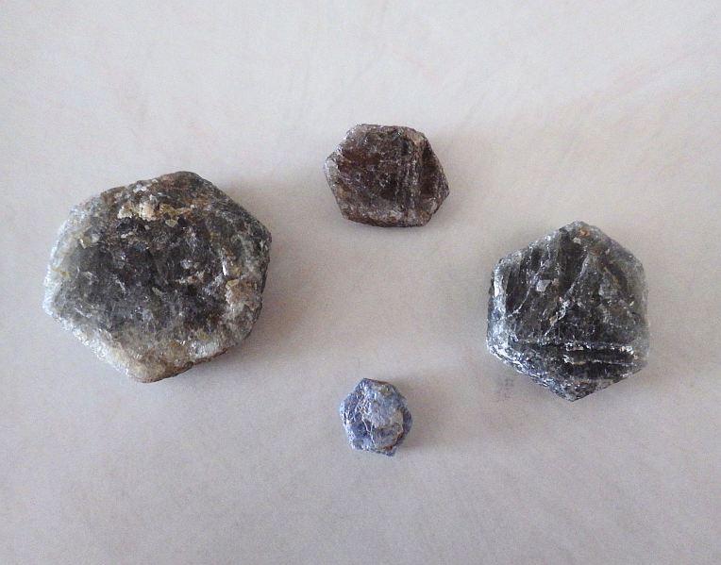
Sapphire from Tanzania

Slide 32
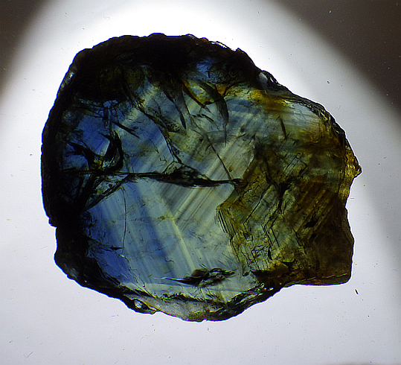
Sapphire from Laos

Slide 33
Other Elements

Slide 34
Density
Density = ~4.0
n_{d} = 1.76

Slide 35
Hexagonal Close Packing

Slide 36
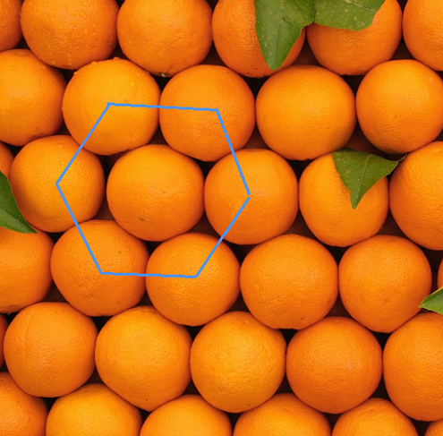
Hexagonal Close Packing

Slide 37
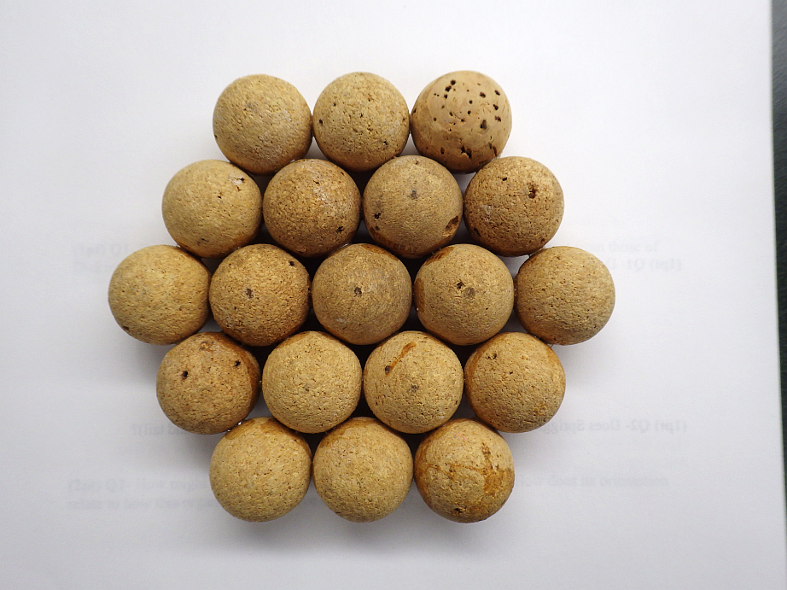

Slide 38
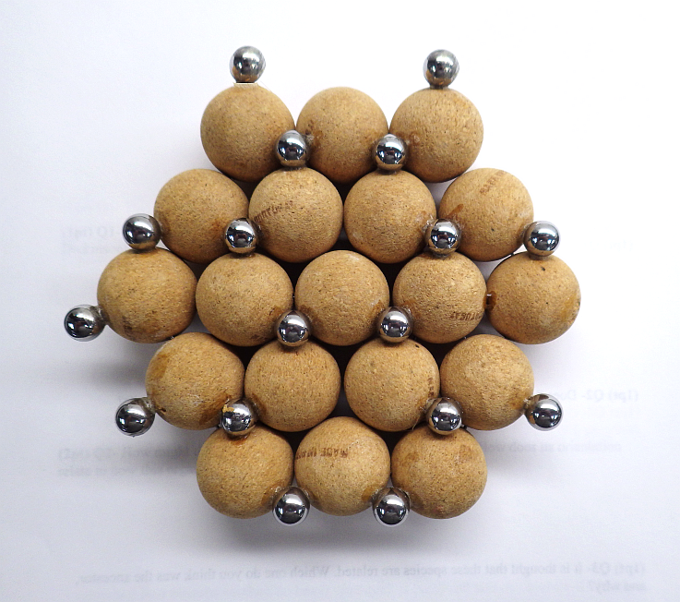

Slide 39
Isostructural

Slide 40
Hematite
Fe₂O₃ isostructural with corundum

Slide 41
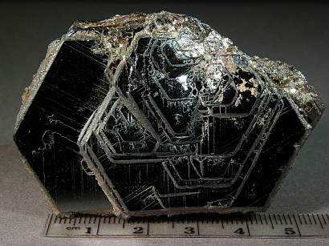
Hematite
Fe₂O₃ isostructural with corundum
Brumado, Bahia, Brazil

Slide 42
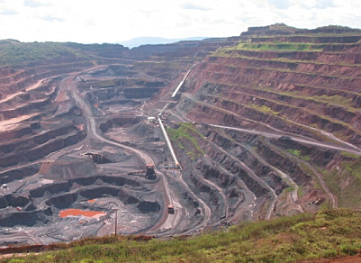
Hematite
Fe₂O₃ isostructural with corundum
An important
ore of iron
Carajas, Brazil

Slide 43
Hematite Color

Slide 44
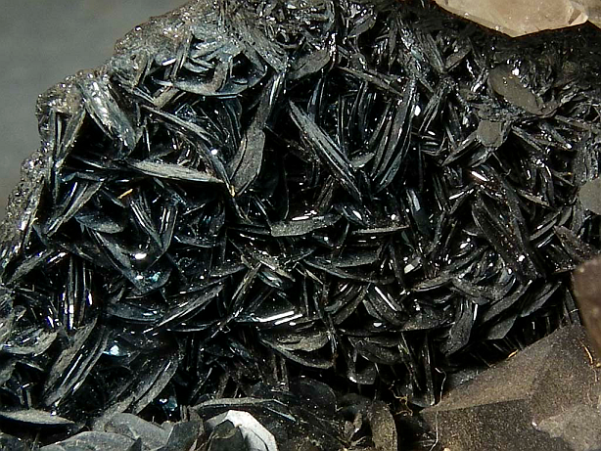
Hematite Crystals
Notes:
Cumberland England

Slide 45
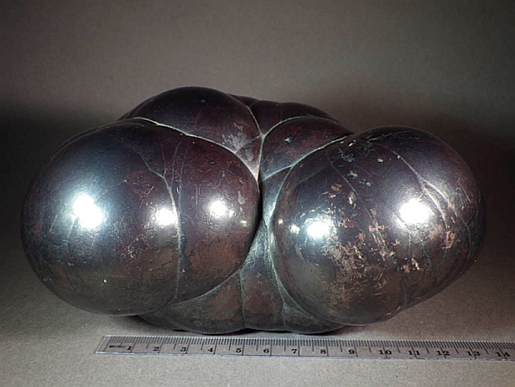
Massive Hematite
Cumberland, England
Notes:
Cumberland England

Slide 46
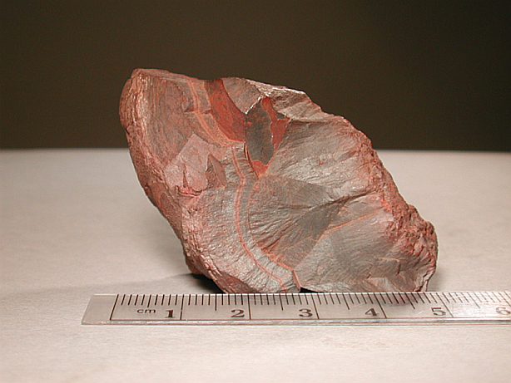
Hematite
Cumberland, England
Notes:
Cumberland England

Slide 47
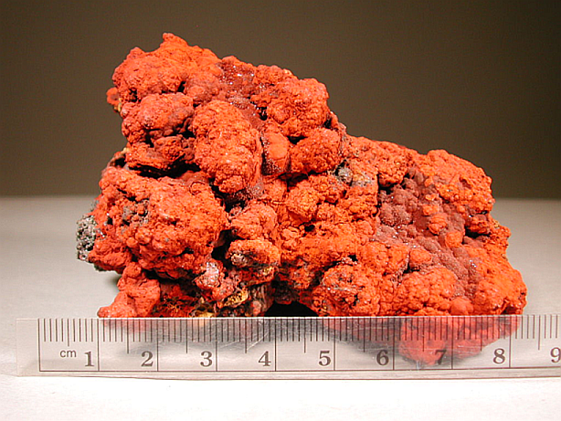
Hematite
Michigan
Notes:
Michigan

Slide 48
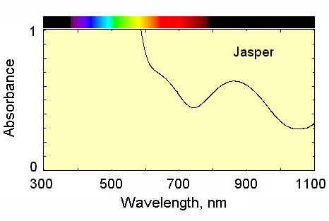
The Hematite Optical Spectrum

Slide 49
Particle Size

Slide 50
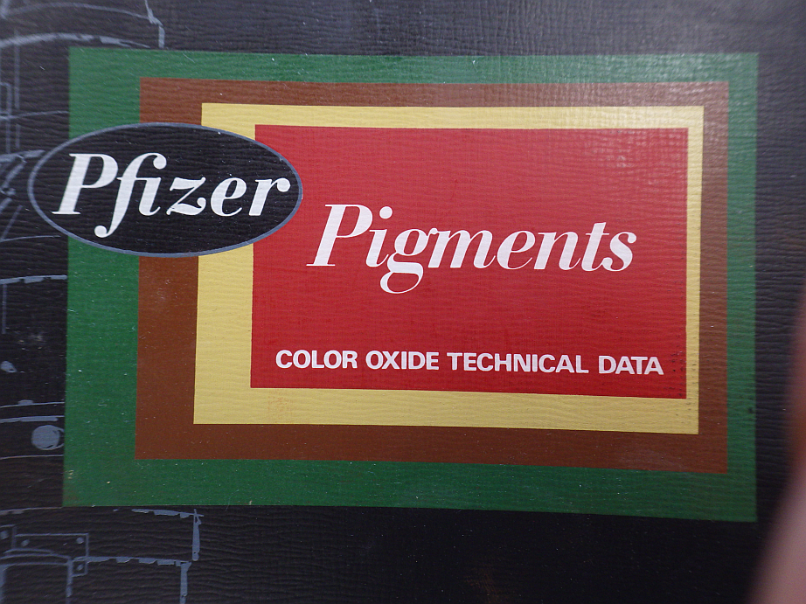
Commercial Pigments

Slide 51
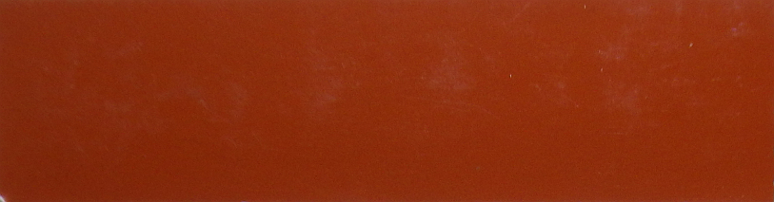
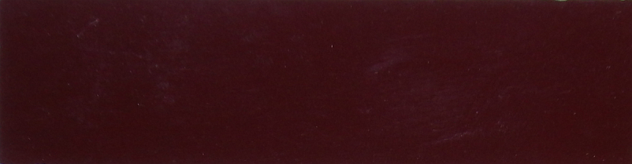
Paint Strips
0.15 μm
2.5 μm

Slide 52
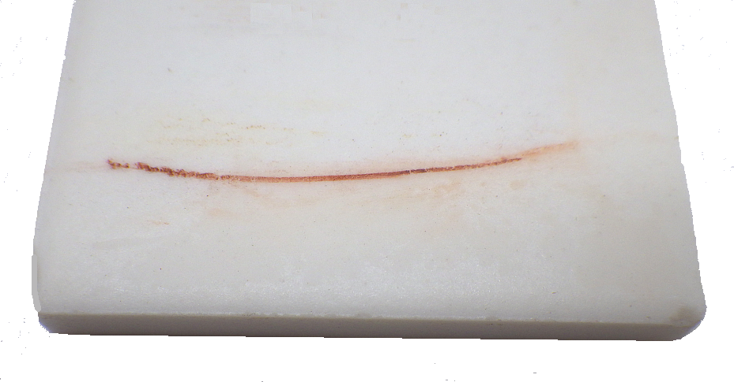
Streak Test

Slide 53
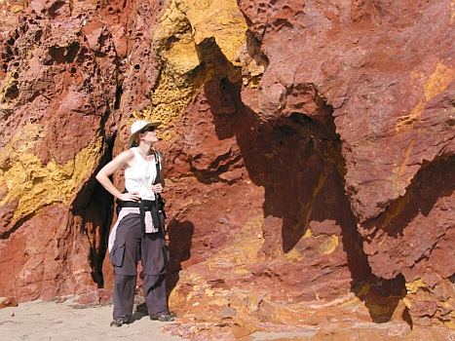
Important Pigment in Soil
NE coast of Brazil

Slide 54
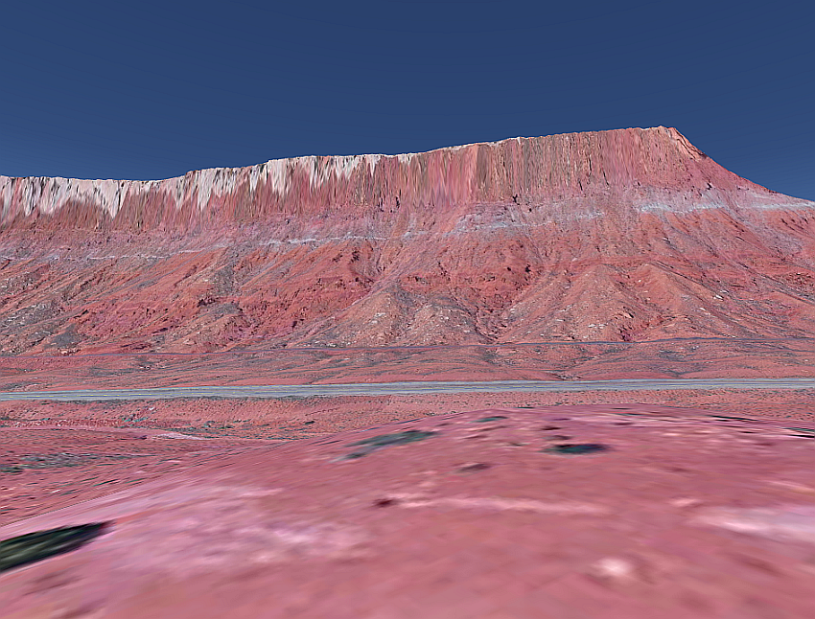
Hematite in Rock
Near Moab, Utah

Slide 55
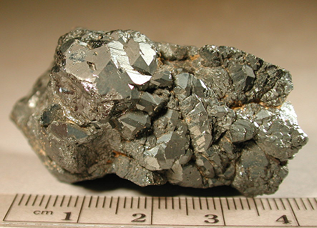
Ilmenite
FeTiO₃
HCP
First found in the Ilmensky Mountains
An important ore of titanium
Commonly found in both igneous and metamorphic rocks.
Concentrates in heavy mineral sands in rivers and beaches.

Slide 56
Ilmenite
Question:
Do Fe and Ti form
separate layers or
do they scramble?

Slide 57
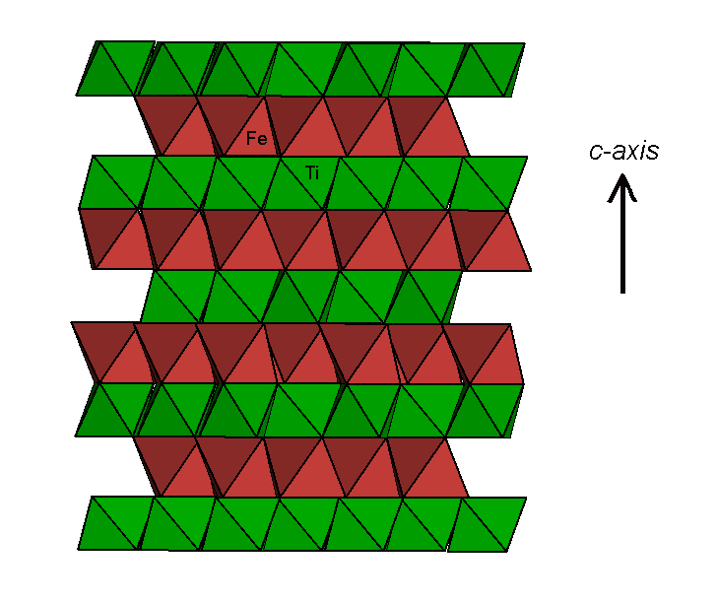
Ilmenite

Slide 58
Exsolution

Slide 59
Ilmenite in basalt is often a solid solution
e.g. Il₈₀Hem₂₀ = 0.8(Fe²⁺Ti⁴⁺O₃) + 0.2(Fe³⁺Fe³⁺O₃)

Slide 60
Ilmenite in basalt is often a solid solution
e.g. Il₈₀Hem₂₀ = 0.8(Fe²⁺Ti⁴⁺O₃) + 0.2(Fe³⁺Fe³⁺O₃)
Envision a reaction: Fe²⁺Ti⁴⁺O₃
Fe³⁺Fe³⁺O₃
Fe²⁺Fe³⁺₂O₄ + TiO₂
magnetite

Slide 61
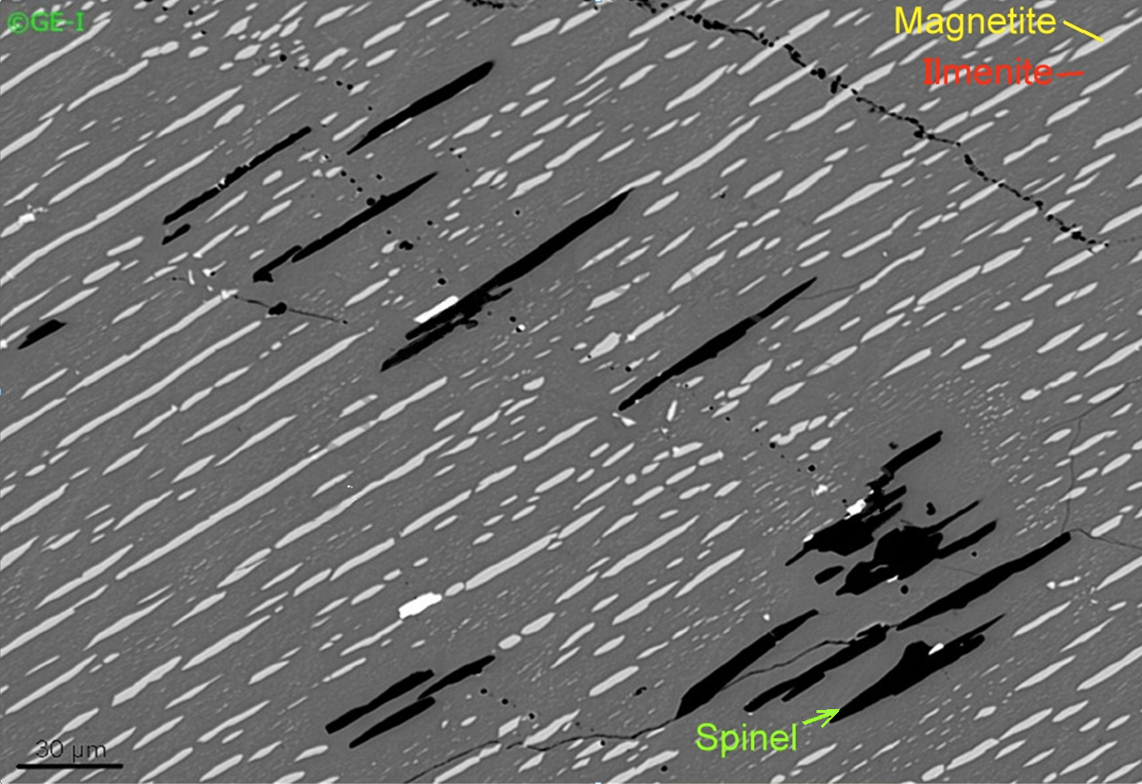

Slide 62
Or, the hematite could exsolve
Il₈₀Hem₂₀ = 0.8(Fe²⁺Ti⁴⁺O₃) + 0.2(Fe³⁺Fe³⁺O₃)
Fe²⁺Ti⁴⁺O₃ + Fe³⁺₂O₃

Slide 63
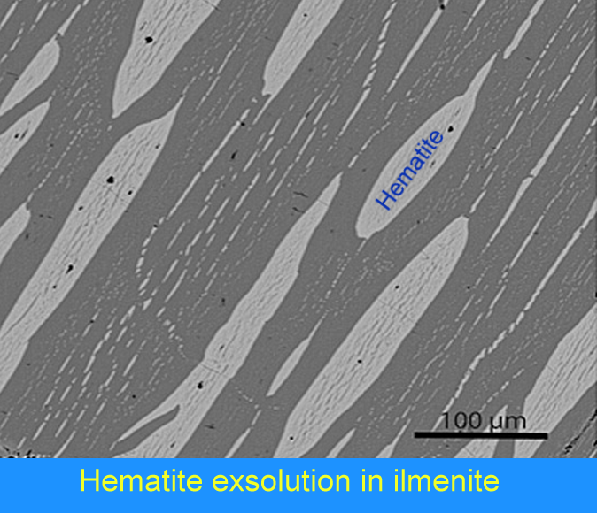

Slide 64
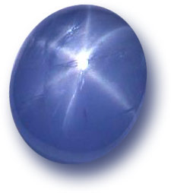
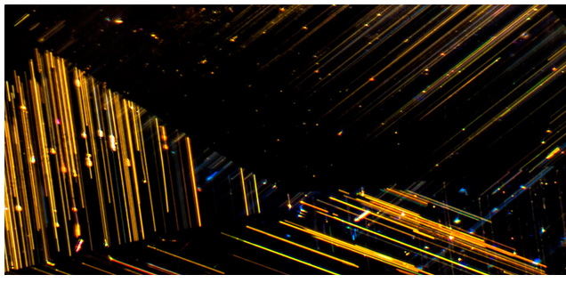
Rutile in Corundum
TiO₂ in Al₂O₃
Star sapphire
Photo Credit: Wikipedia Commons
John Koivula in lotusgemology.com

